Slide 1
Capstone Engagement
Assessment, Analysis, and Hardening of a Vulnerable System
Nicholas Williams 2/28/22

Slide 2
Table of Contents
This document contains the following sections:
01
Network Topology
02
Red Team: Security Assessment
03
Blue Team: Log Analysis and Attack Characterization
Hardening: Proposed Alarms and Mitigation Strategies
04

Slide 3
Network Topology
‹#›

Slide 4
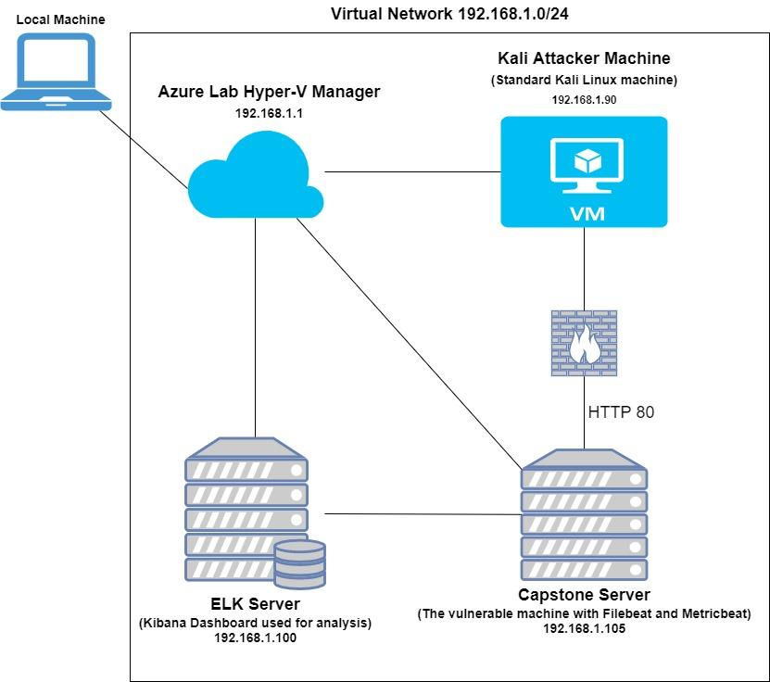
Network Topology
[Insert Here]
Network
Address Range: 192.168.1.0/24
Netmask: 255.255.255.0
Gateway: 192.168.1.1
Machines
IPv4: 192.168.1.1
OS: Windows
Hostname:
Hyper-V Manager
IPv4: 192.168.1.90
OS: Kali Linux
Hostname: Kali
IPv4: 192.168.1.105
OS: Linux
Hostname: Capstone
IPv4: 192.168.1.100
OS: Linux
Hostname: ELK

Slide 5

Red Team
Security Assessment
‹#›

Slide 6
Recon: Describing the Target
Nmap identified the following hosts on the network:
Hostname | IP Address | Role on Network
Hyper-V Manager | 192.168.1.1 | This is the lab environment virtualizer.
Kali | 192.168.1.90 | This Kali Linux machine is the attacking machine.
ELK | 192.168.1.100 | This machine hosts the Kibana Dashboard used for Blue Team analysis.
Capstone | 192.168.1.105 | This is the vulnerable linux server that will be attacked in this project. This host has Filebeat and Metricbeat installed sending log data to the ELK machine.

Slide 7
Vulnerability Assessment
The assessment uncovered the following critical vulnerabilities in the target:
Vulnerability | Description | Impact
CWE-22: Improper Limitation of a Pathname to a Restricted Directory ('Path Traversal') | The vulnerability means that directories which should be hidden are not. The files can be found by brute forcing file path names until a web page is discovered, using tools like ‘dirb’. | This vulnerability gives attackers the ability to find hidden directories that they can then look at and exploit.
CWE-307: Improper Restriction of Excessive Authentication Attempts | There is no security implemented to restrict failed authentication attempts meaning that a brute force attack can run unimpeded on the site. | Attackers can brute force the sites username and password authentication page until they crack it.
CWE-98: Improper Control of Filename for Include/Require Statement in PHP Program ('PHP Remote File Inclusion') | The PHP program running on the server is allowing remote file inclusion to execute. | It allows attackers to add files (like malware) to the server and run them.

Slide 8
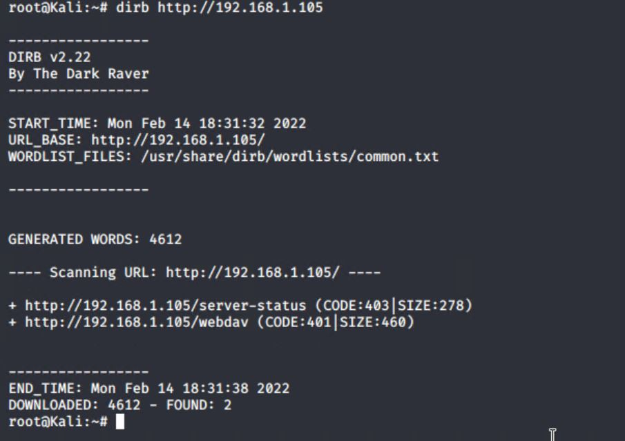
Exploitation: CWE-22
01
02
03
Tools & Processes
Using the “dirb” command we were able to expose two web files that were not meant to be publicly accessible.
The command was:
‘dirb http://192.168.1.105’
Achievements
The result returned two file paths:
/server-status
And
/webdav

Slide 9
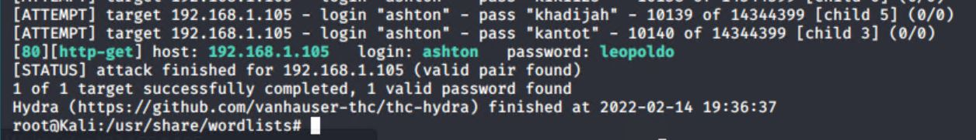
Exploitation: CWE-307
01
02
03
Tools & Processes
We used the command line tool Hydra to brute force the authentication protocols on the website.
The command used:
‘hydra -l ashton -P /usr/share/wordlists/rockyou.txt -s 80 -f -vV 192.168.1.105 http-get HTTP://192.168.1.105/company_folders/secret_folder’
Achievements
Using this brute force we were able to discover the password for Ashton’s account and could now access the restricted file.
See Below:

Slide 10
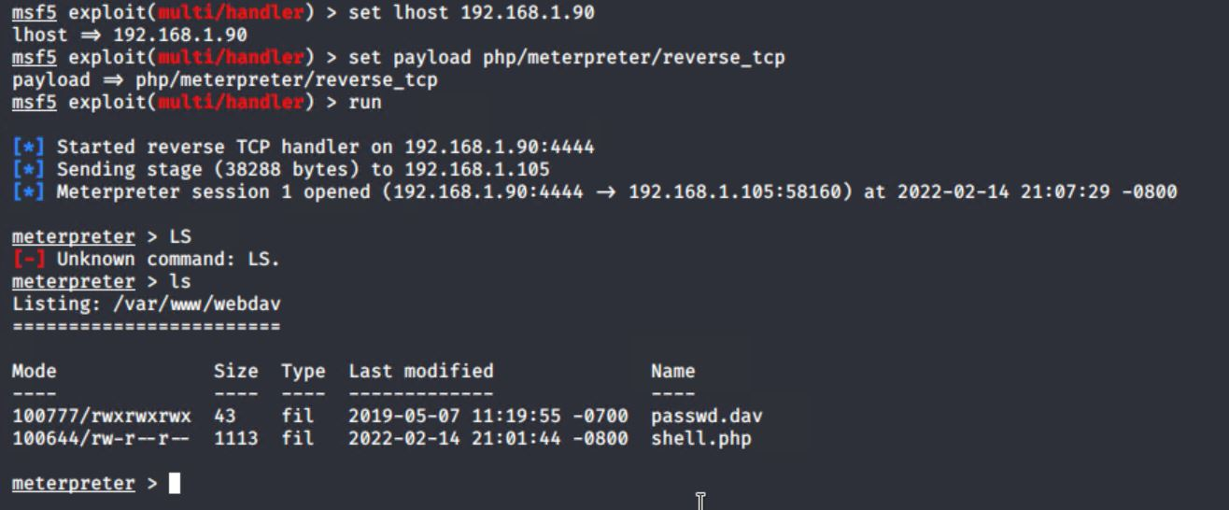
Exploitation: CWE-98
01
02
03
Tools & Processes
We were able to use MSFVenom to design and upload a PHP reverse shell into the server.
Achievements
The exploit gave us a backdoor ‘meterpreter’ connection into the server.
See Below:

Slide 11

Blue Team
Log Analysis and Attack Characterization
‹#›

Slide 12

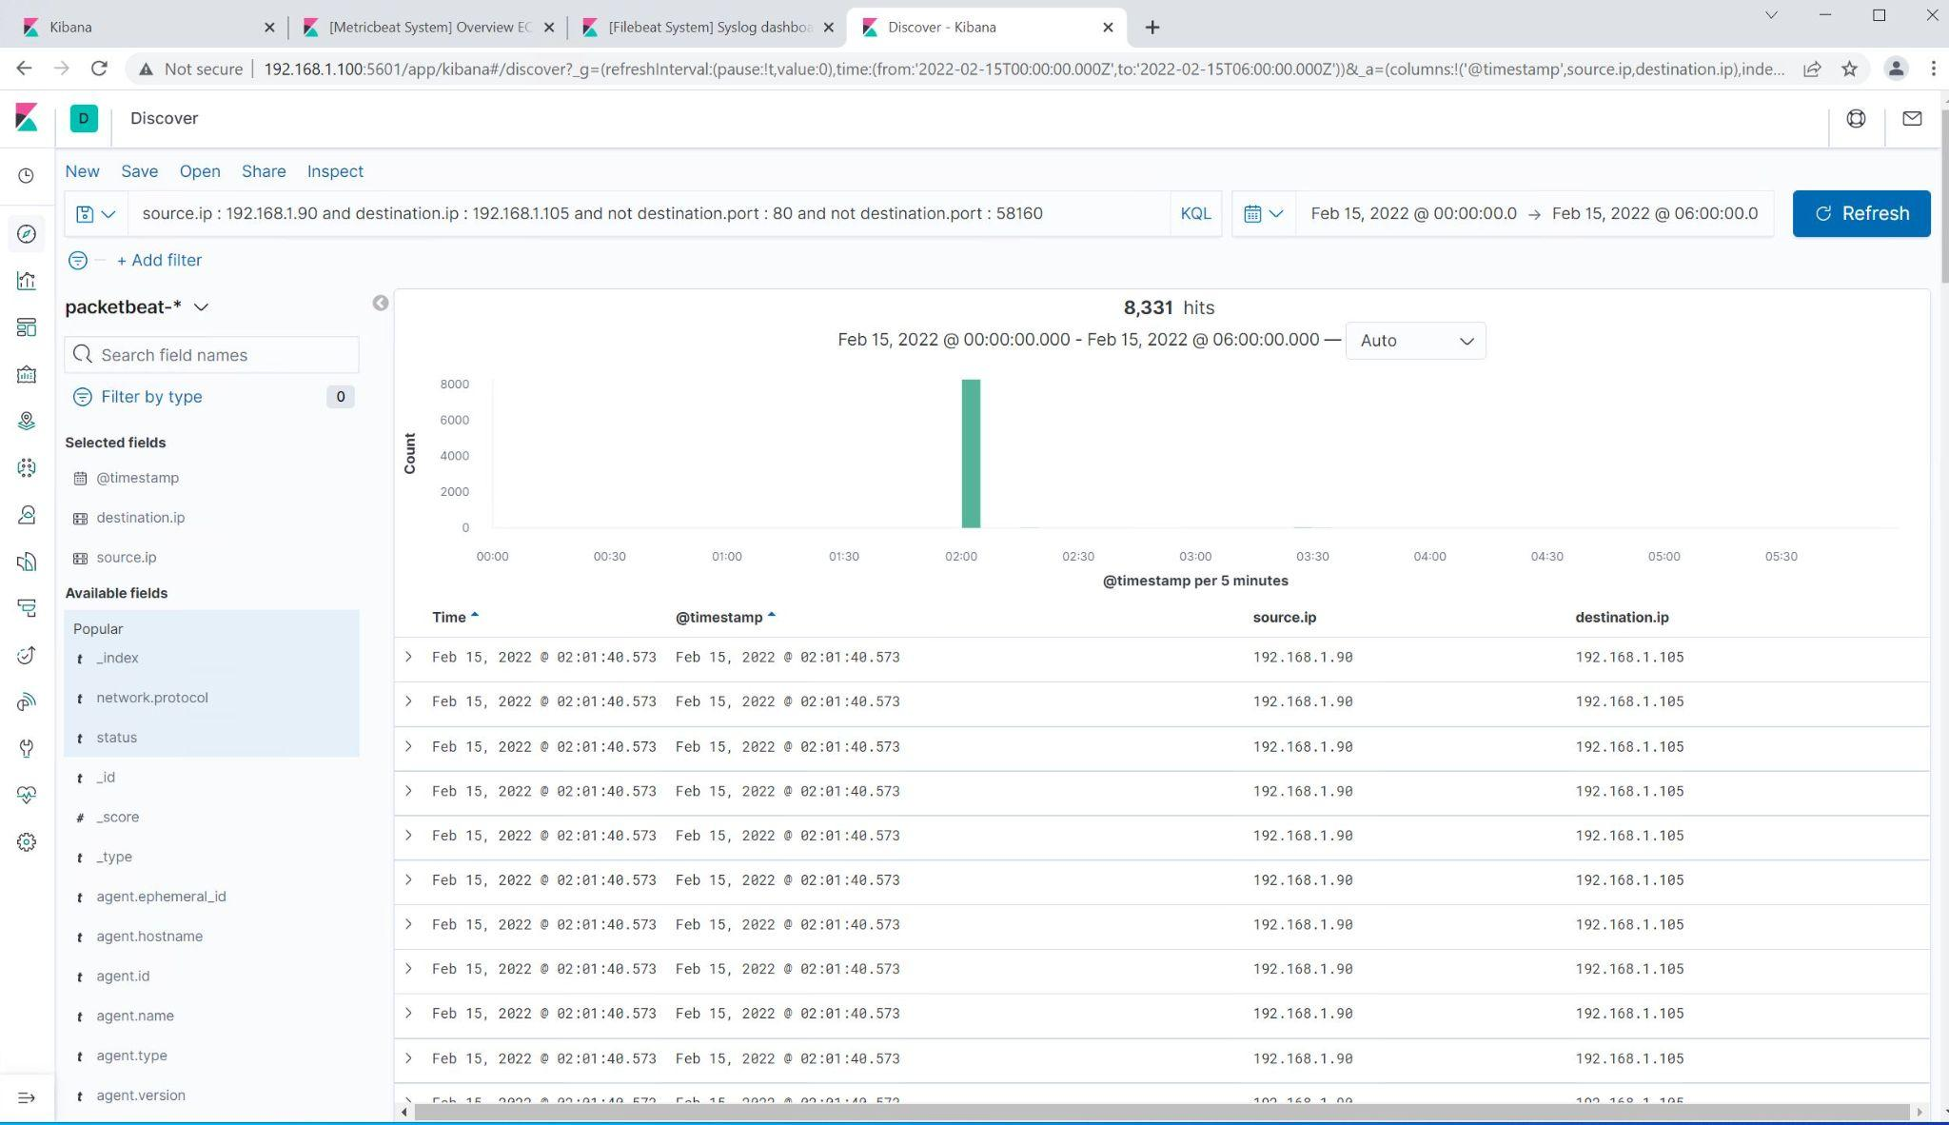
Analysis: Identifying the Port Scan
What time did the port scan occur?
The port scan began on february 15th, 2022 at 2:01 AM
How many packets were sent, and from which IP?
There were initially 8,301 hits recorded around the start of the attack.
What indicates that this was a port scan?
This was a port scan because the destination ports were checked.

Slide 13
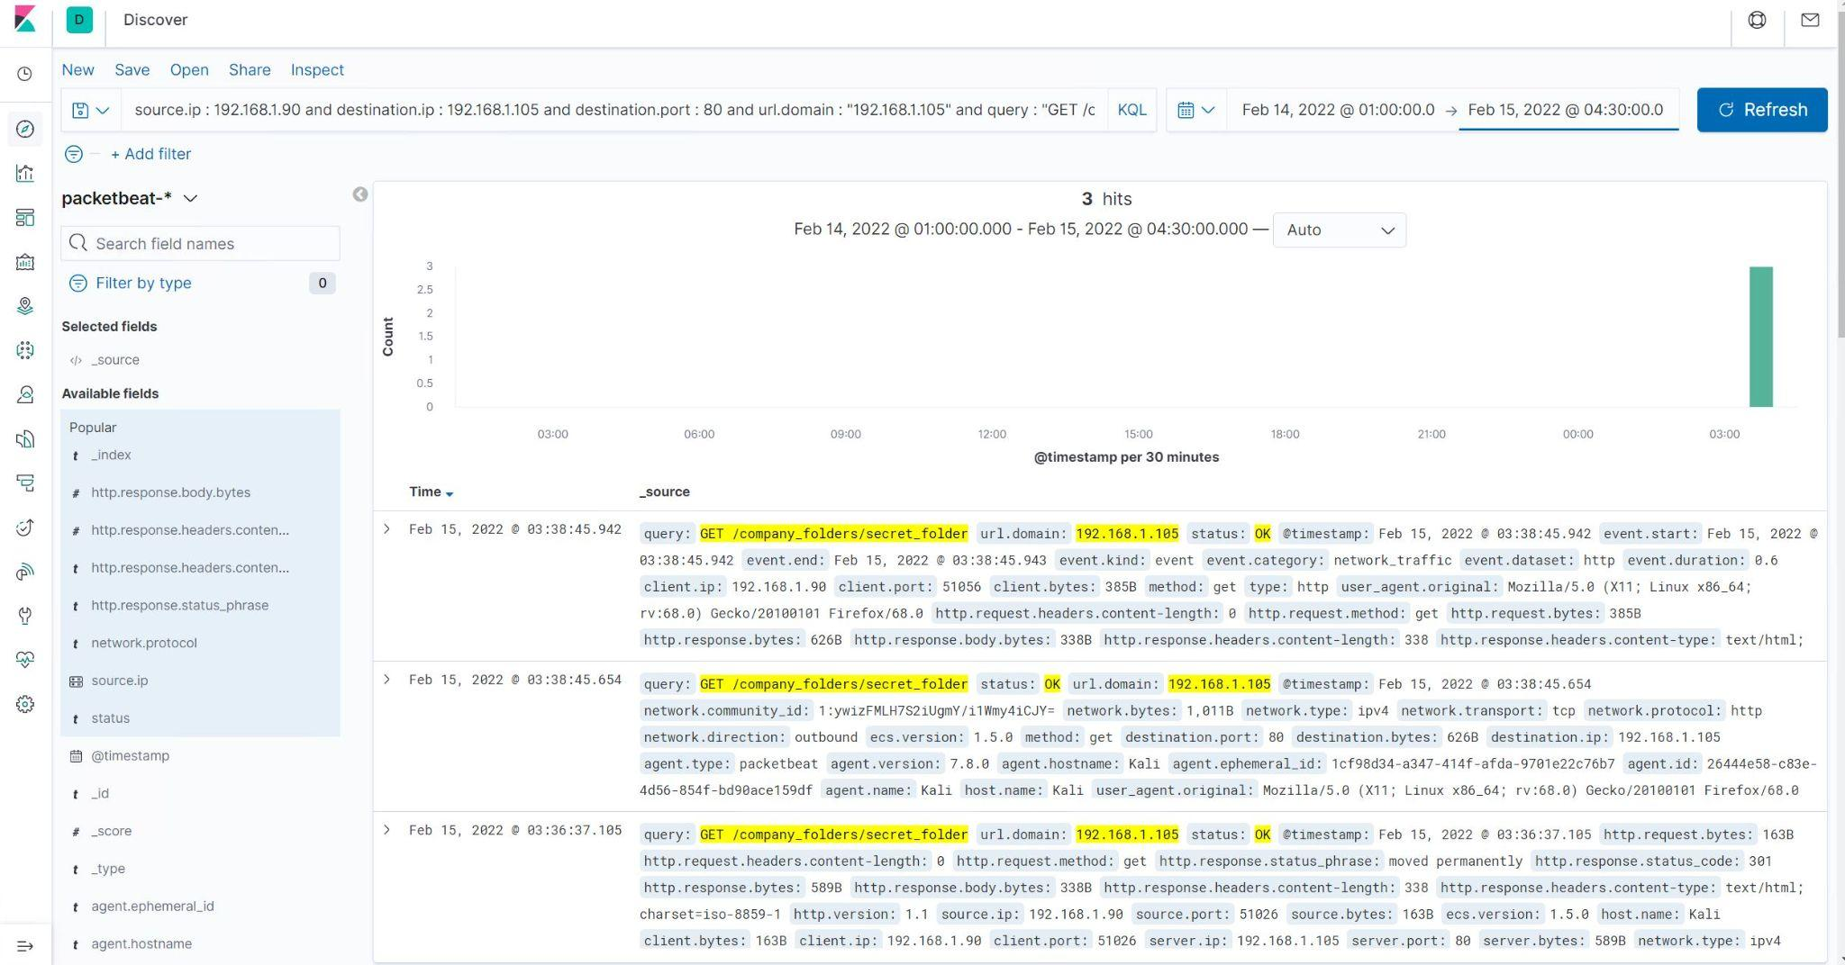
Analysis: Finding the Request for the Hidden Directory
What time did the request occur? How many requests were made?
The request for the Hidden Directory began on February 15th, 2022 at 3:38 AM
Which files were requested? What did they contain?
The requested file was the /secret_folder directory and it contained the information on how to access the secured corporate server.

Slide 14
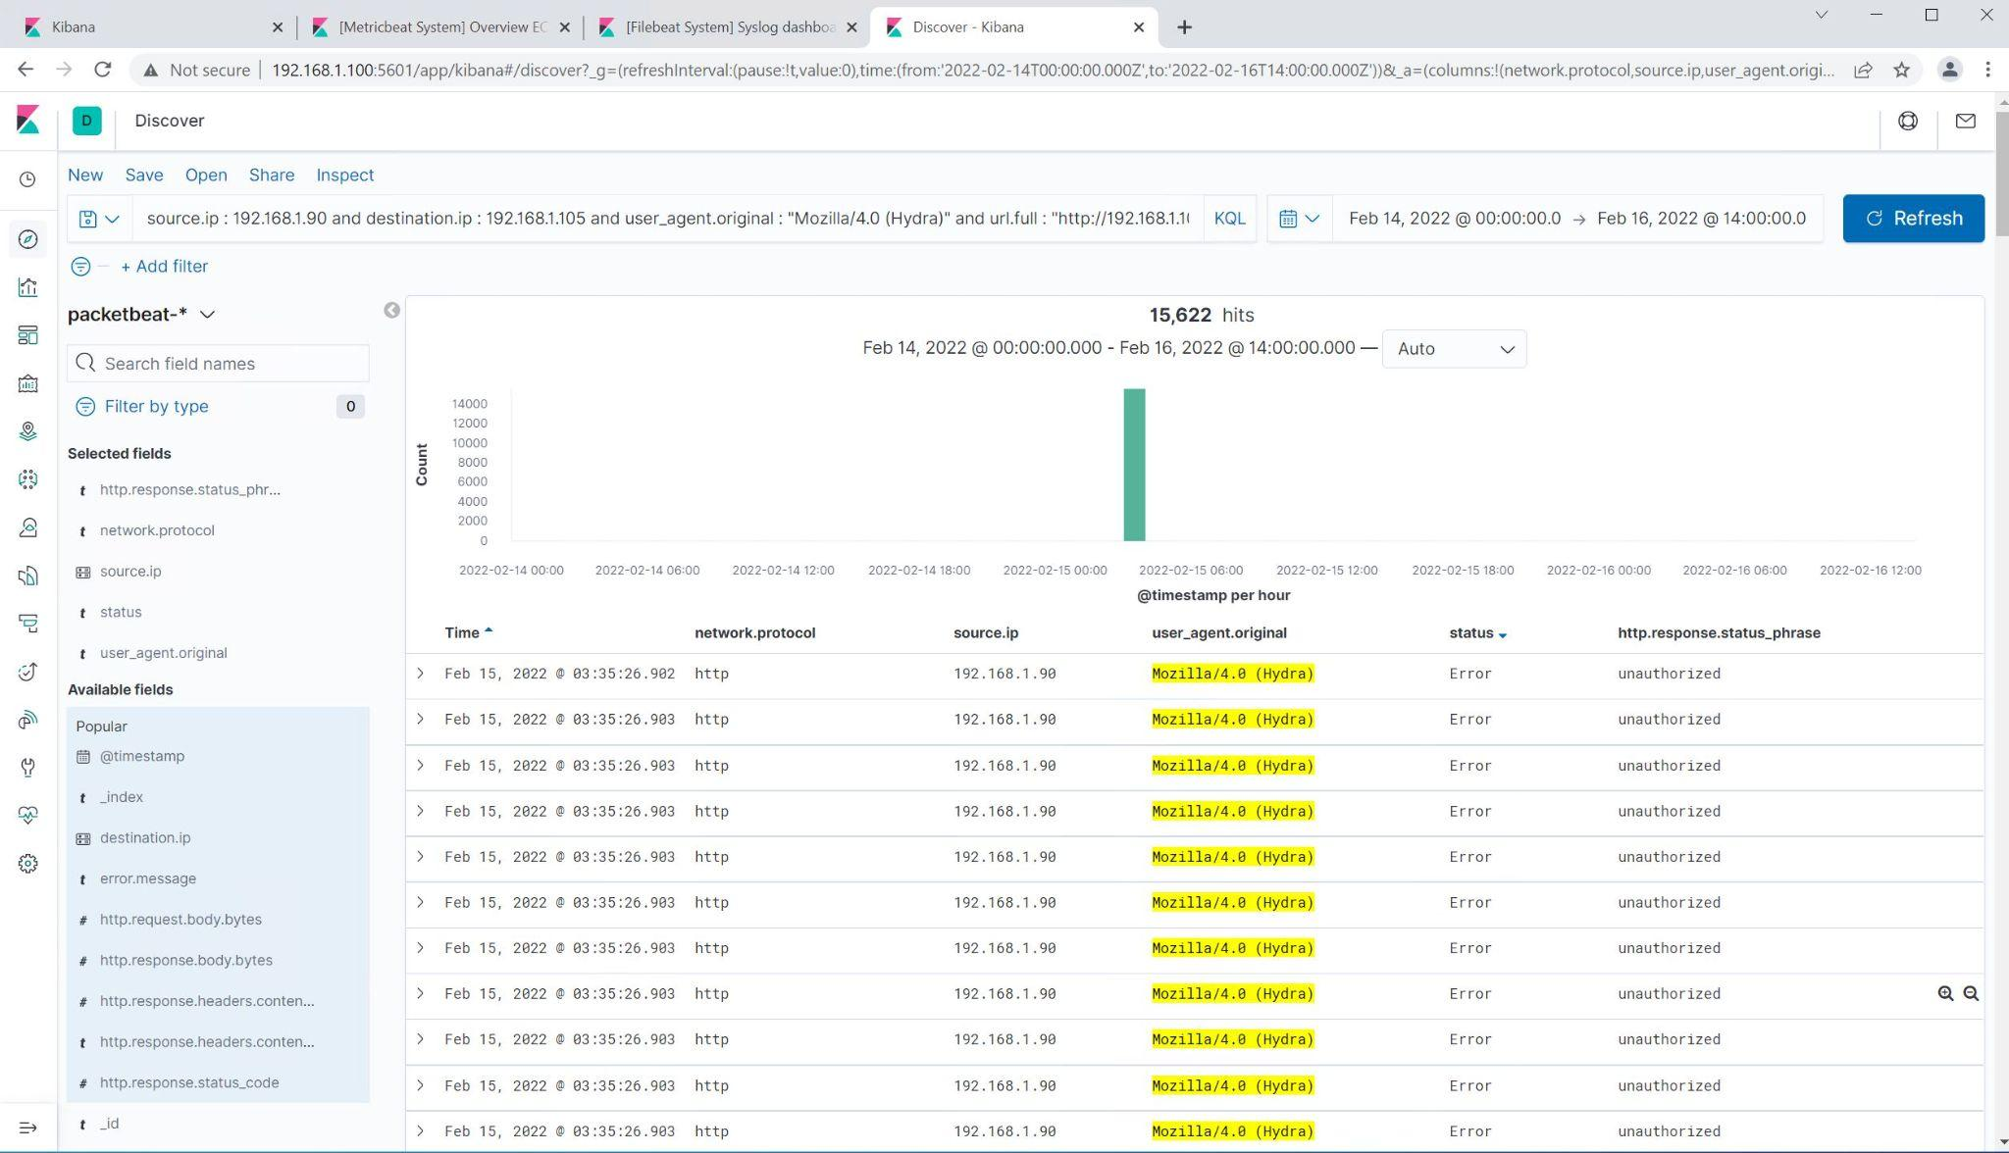
Analysis: Uncovering the Brute Force Attack
How many requests were made in the attack?
There were 15,622 attempts by the Hydra program to brute force the authentication.
How many requests had been made before the attacker discovered the password?
10,140 attempts.

Slide 15
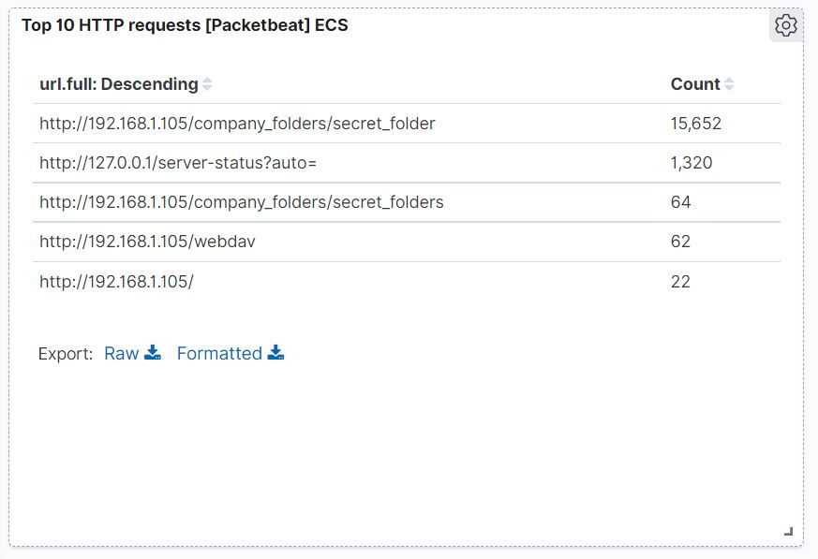
Analysis: Finding the WebDAV Connection
How many requests were made to this directory?
The webdav directory was accessed 62 times.
Which files were requested?
http://192.168.1.105/webdav

Slide 16
Blue Team
Proposed Alarms and Mitigation Strategies
‹#›

Slide 17
Mitigation: Blocking the Port Scan
What kind of alarm can be set to detect future port scans?
An alert condition can be created in the SIEM that the company uses like Splunk-Enterprise and can be set to notify security personnel when a singular IP address is attempting connection to multiple ports in rapid succession.
What threshold would you set to activate this alarm?
Alert when an IP address connects to over ten ports within a ten minute period.
What configurations can be set on the host to mitigate port scans?
Settings can be put into the firewall to block traffic from an IP address that is connecting to more then one port in a short amount of time.
Describe the solution. If possible, provide required command lines.
Using the host based firewall or IPS you could set it to block traffic from IP addresses that repeatedly access different ports.

Slide 18
Mitigation: Finding the Request for the Hidden Directory
What kind of alarm can be set to detect future unauthorized access?
An alert can be designed that will detect when a new IP address not already in the permitted list accesses the protected folder.
What threshold would you set to activate this alarm?
I would input an alert to the SIEM that alerts when an unrecognized IP accesses the folder.
What configuration can be set on the host to block unwanted access?
If this folder is meant to be secure it should be moved to a different server that is not public facing.
Describe the solution. If possible, provide required command lines.
Move the folder to a server that is not public.

Slide 19
Mitigation: Preventing Brute Force Attacks
What kind of alarm can be set to detect future brute force attacks?
An alert should be built to notify when an account username has had multiple incorrect passwords.
What threshold would you set to activate this alarm?
An alert for any time an account has five or more incorrect password attempts.
What configuration can be set on the host to block brute force attacks?
Build in authentication protocols that lock out an account when there is over five incorrect password attempts within a 15 minute period.
Describe the solution. If possible, provide the required command line(s).
Depending on the authentication protocol the system will need to be configured to block excessive failed attempts.

Slide 20
Mitigation: Detecting the WebDAV Connection
What kind of alarm can be set to detect future access to this directory?
An alert can be designed for any time someone accesses the webdav directory outside of the company area.
What threshold would you set to activate this alarm?
I would implement an alert for any time an IP address outside of the company state accesses the file.
What configuration can be set on the host to control access?
Connection to this server should be restricted to only authorized personnel.
Describe the solution. If possible, provide the required command line(s).
This server could only allow access from specific white listed IPs and the authorized users should be forced to use secure authentication methods.

Slide 21
Mitigation: Identifying Reverse Shell Uploads
What kind of alarm can be set to detect future file uploads?
An alert can be made that detects when a .php file is added to the webdav server.
What threshold would you set to activate this alarm?
Any time that a .php file is requested.
What configuration can be set on the host to block file uploads?
The webdav server must be changed to block uploading files to the server.
Describe the solution. If possible, provide the required command line.
Block file creation and upload.

